Slide 1


GitHub Repo:
https://github.com/Ainedembe-Denis/BBC-News-Summary-ML-DL-Project

Slide 2
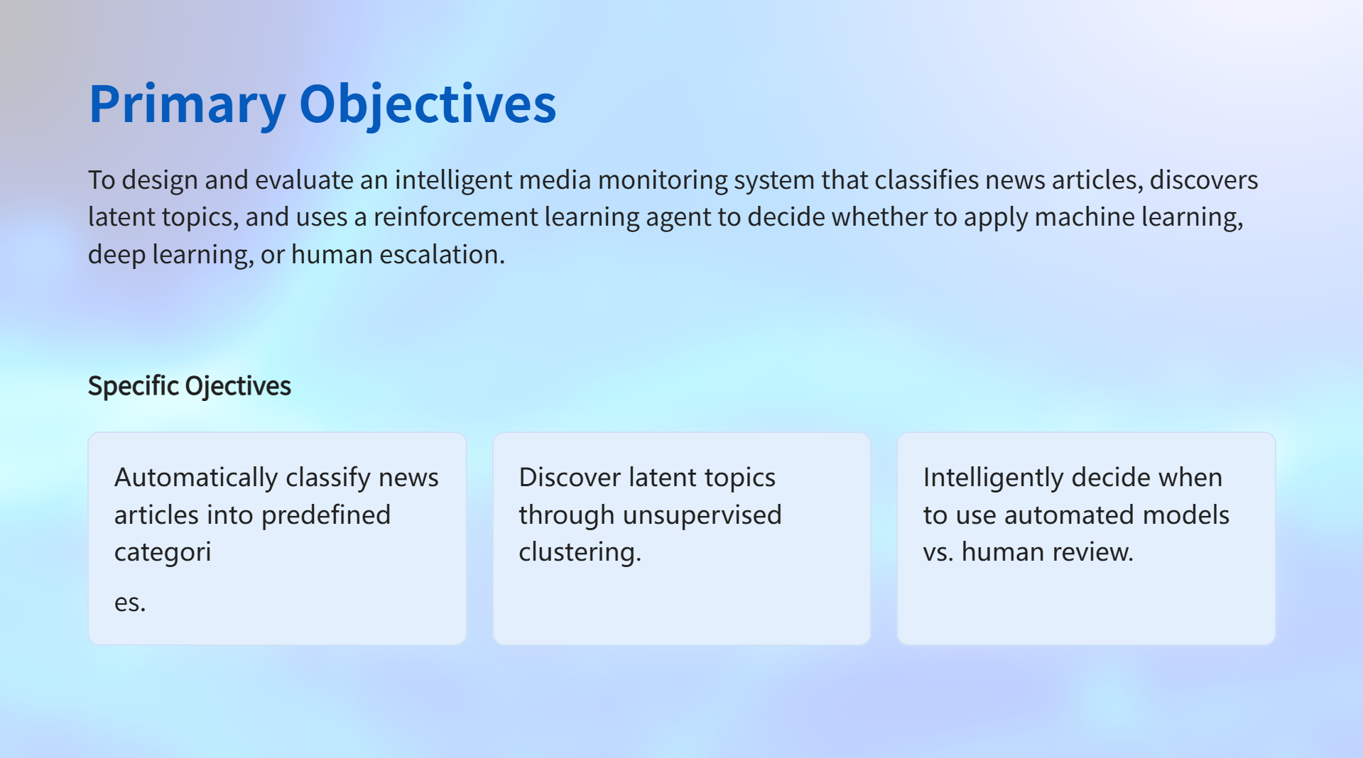

Slide 3
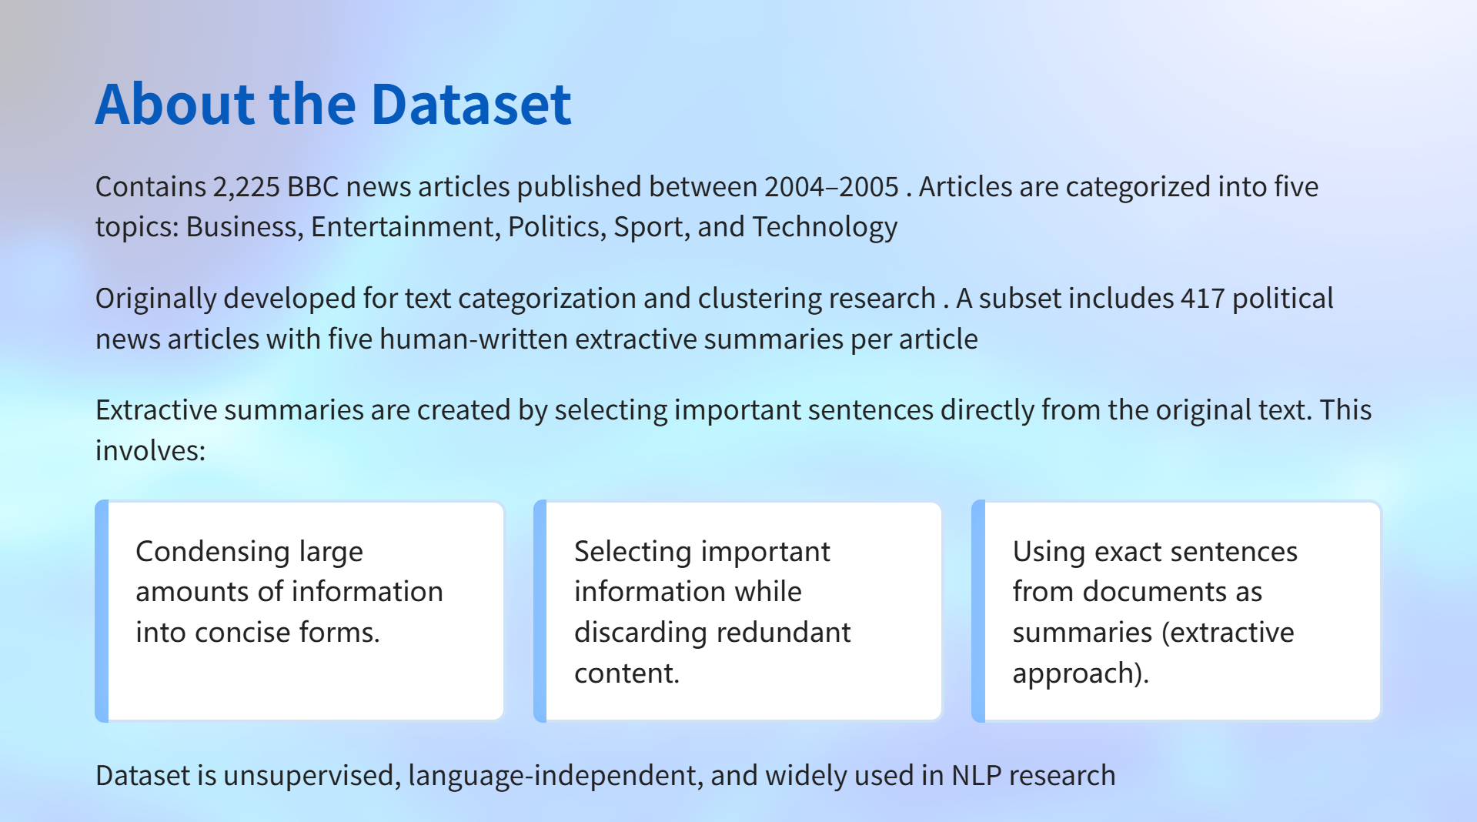

Slide 4
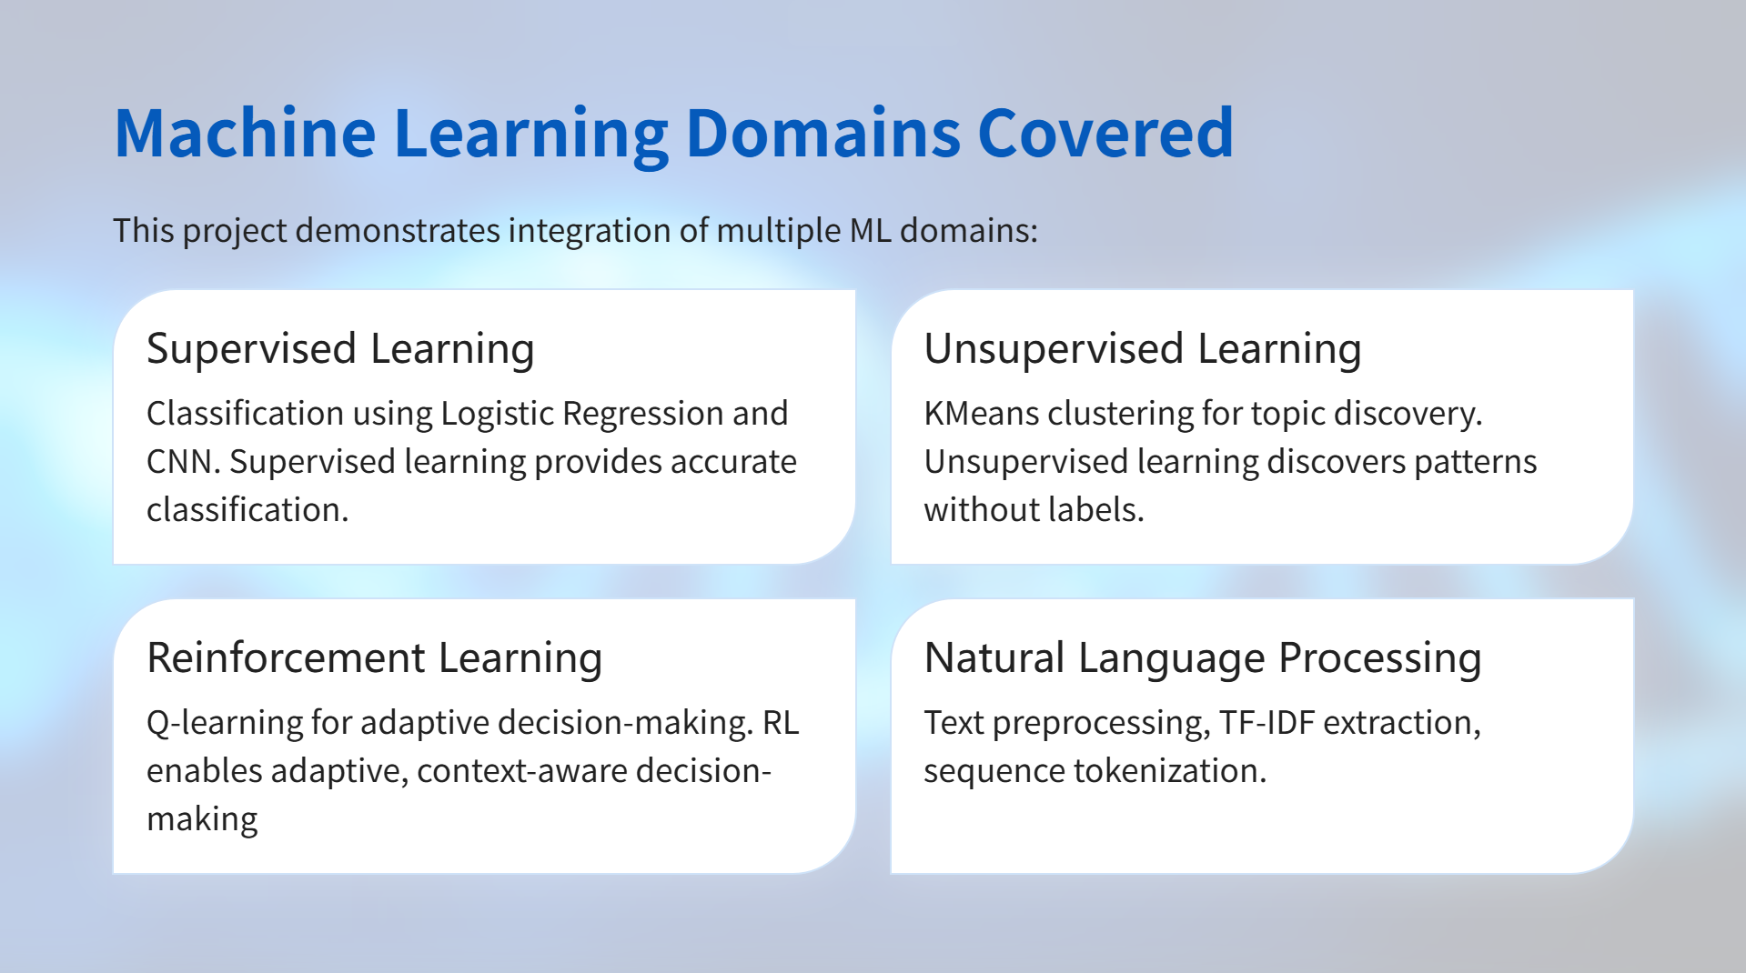

Slide 5
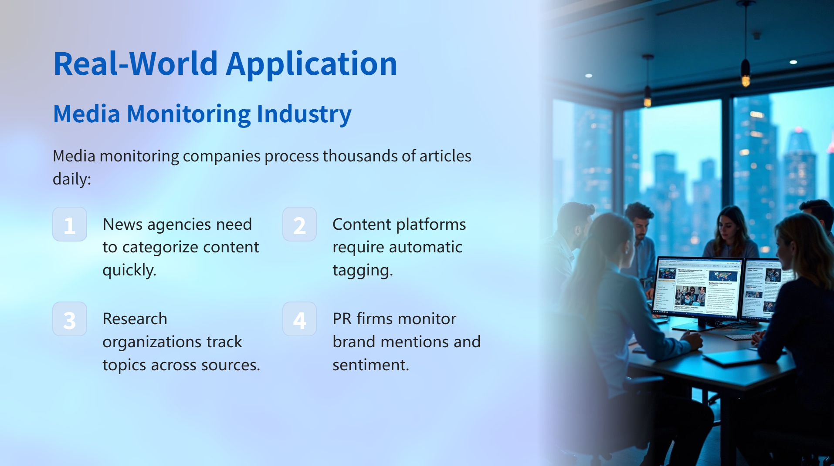

Slide 6
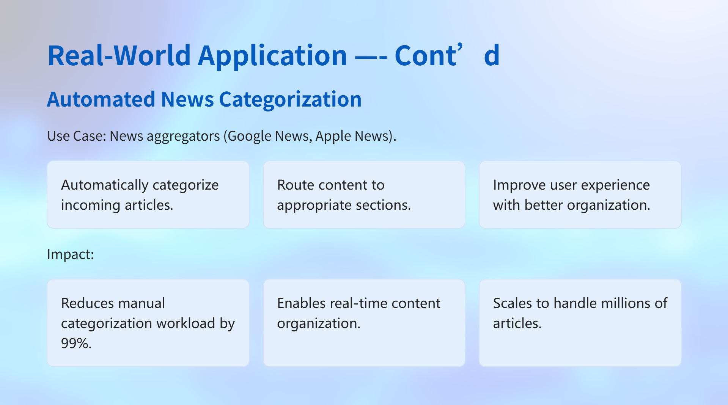

Slide 7
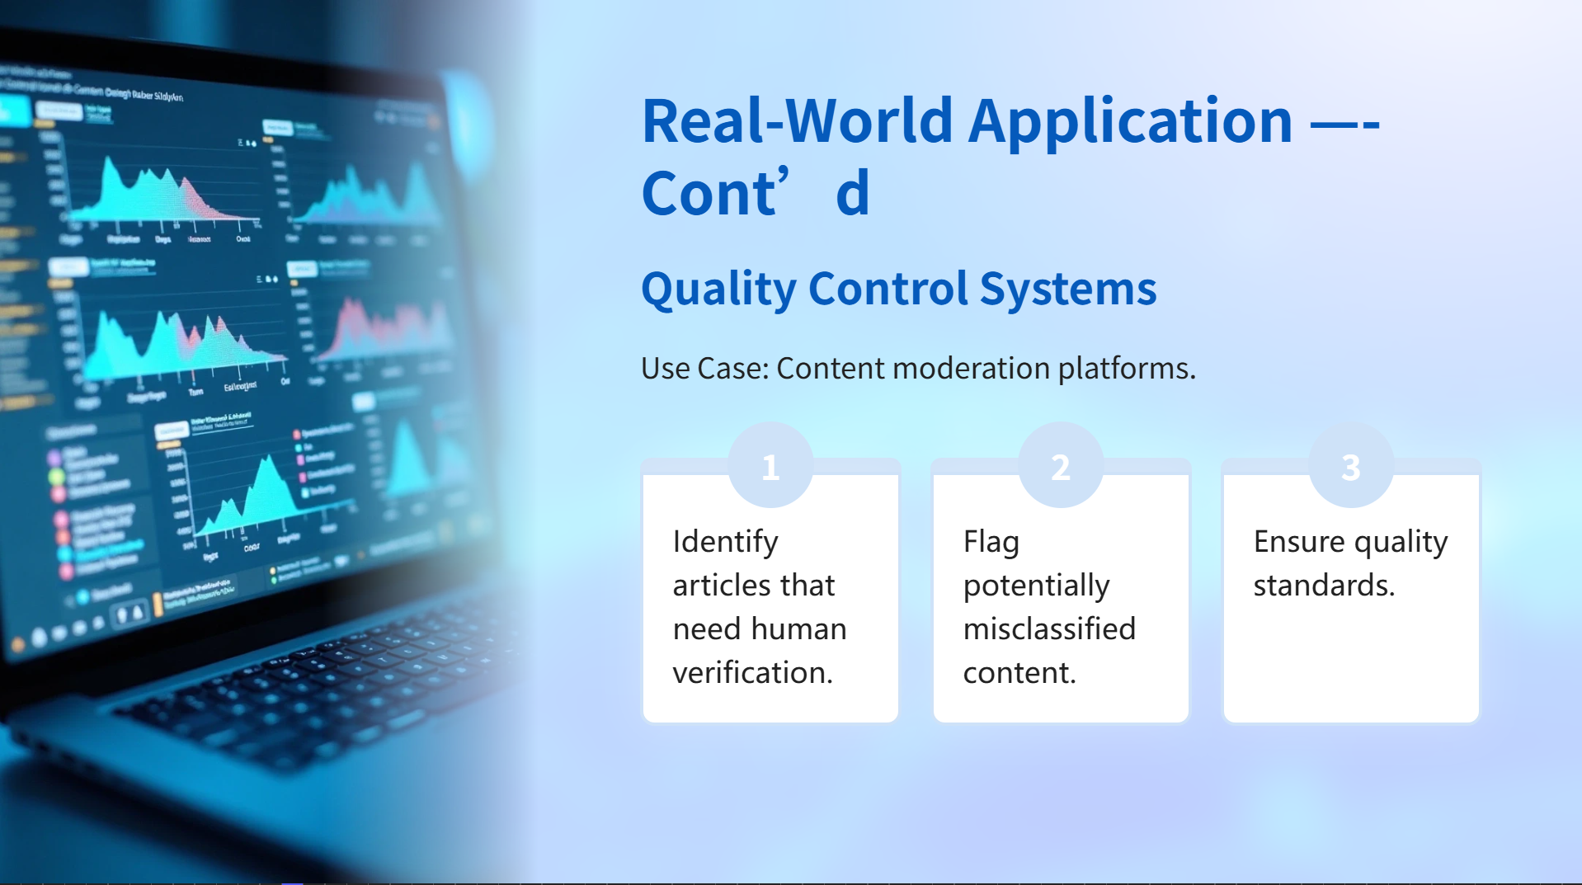

Slide 8
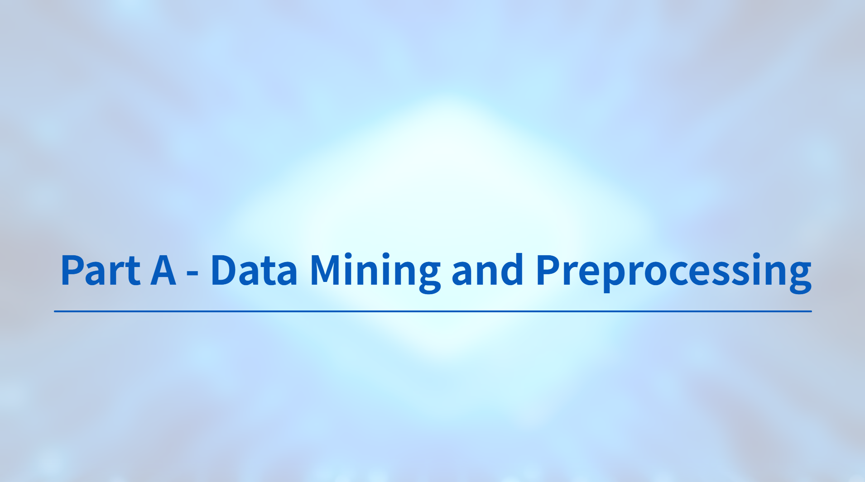

Slide 9
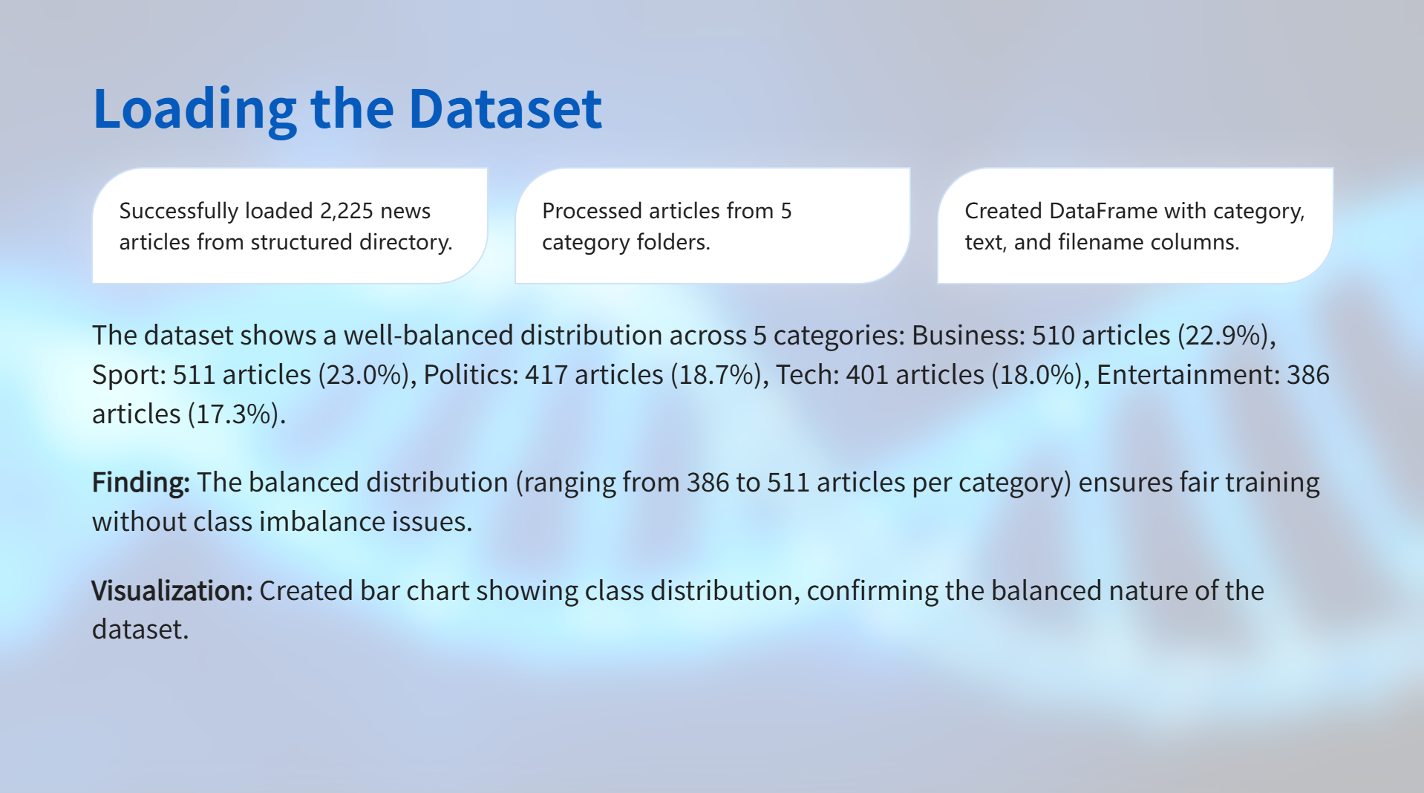

Slide 10
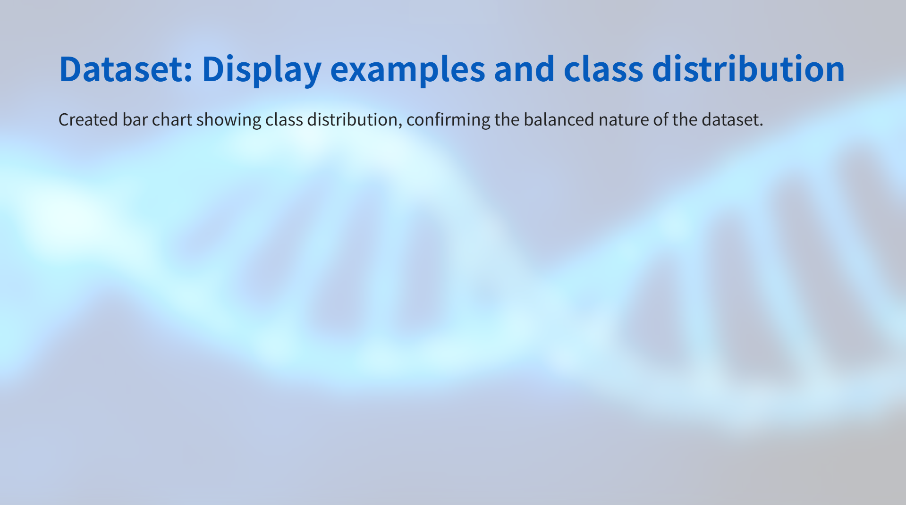
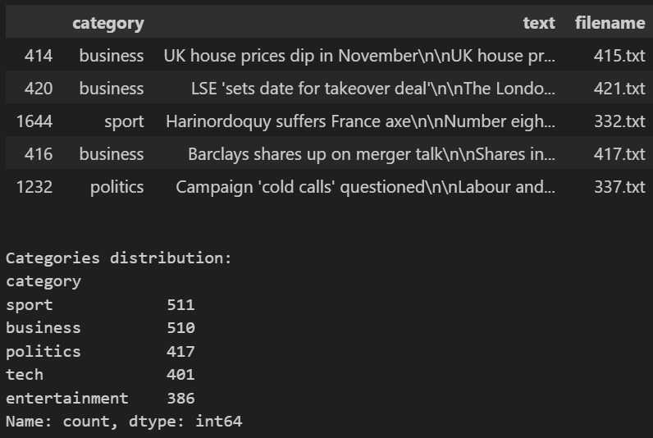
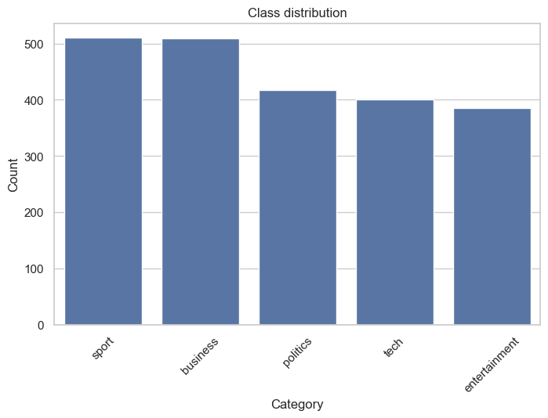

Slide 11
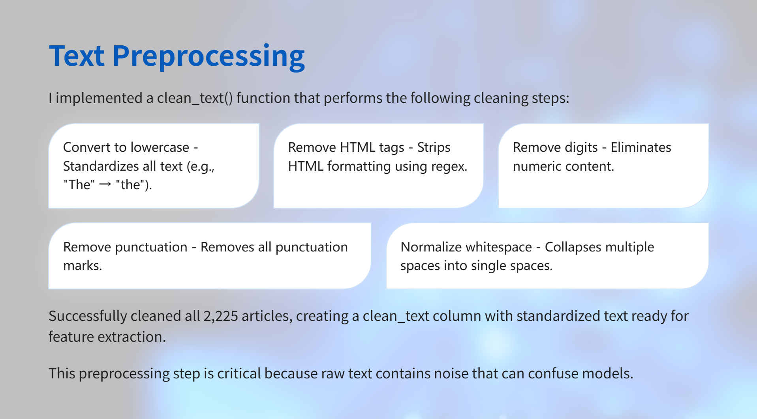

Slide 12
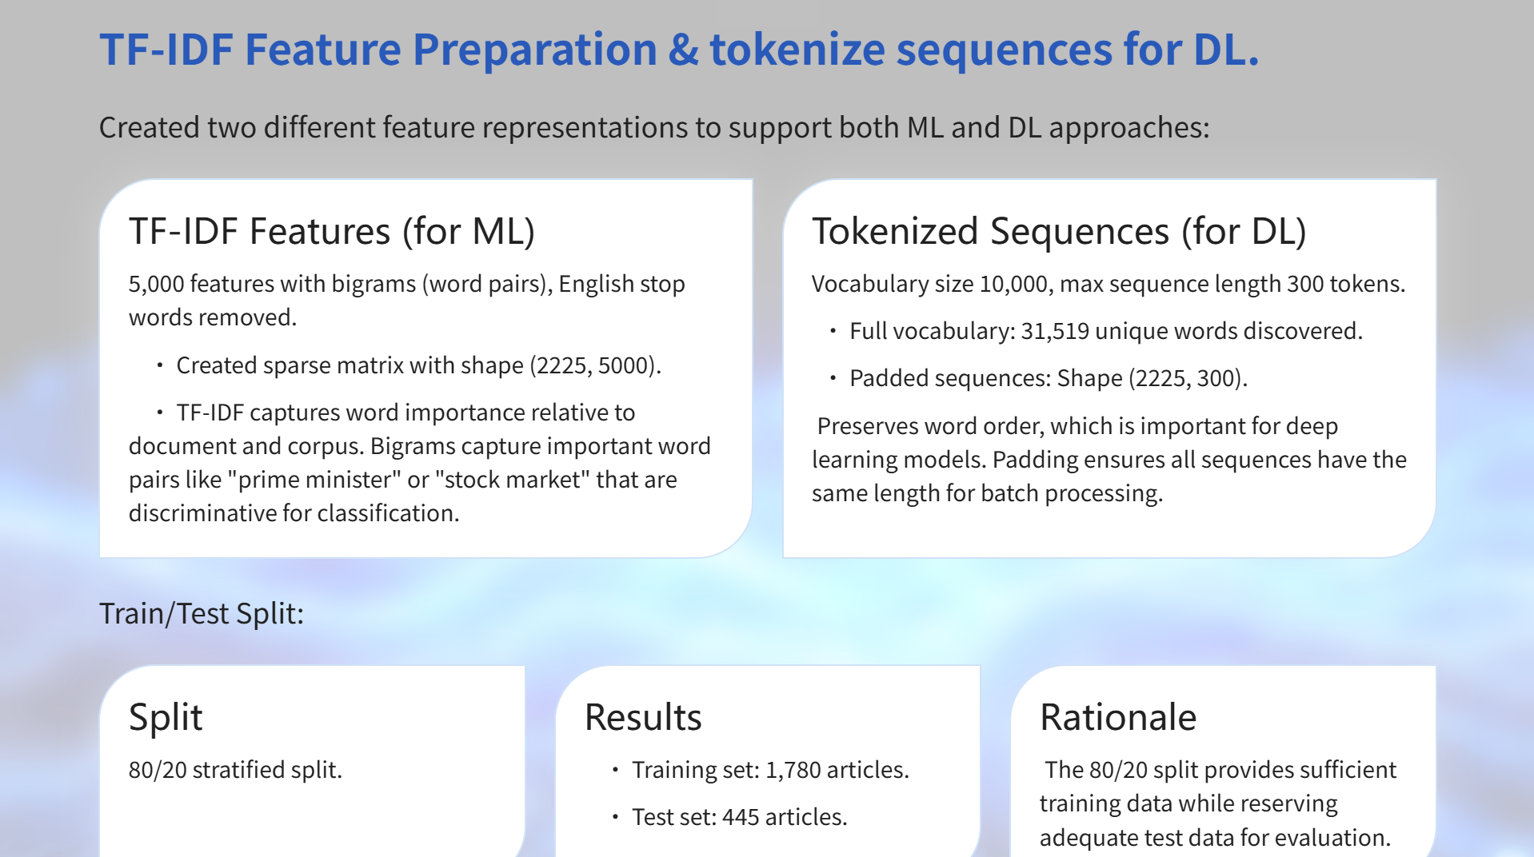

Slide 13
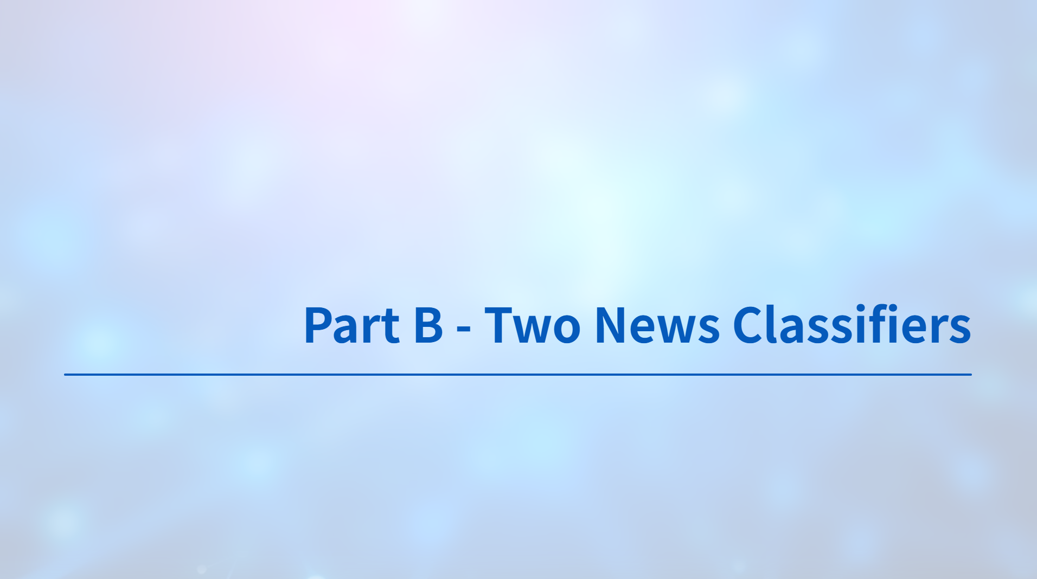

Slide 14
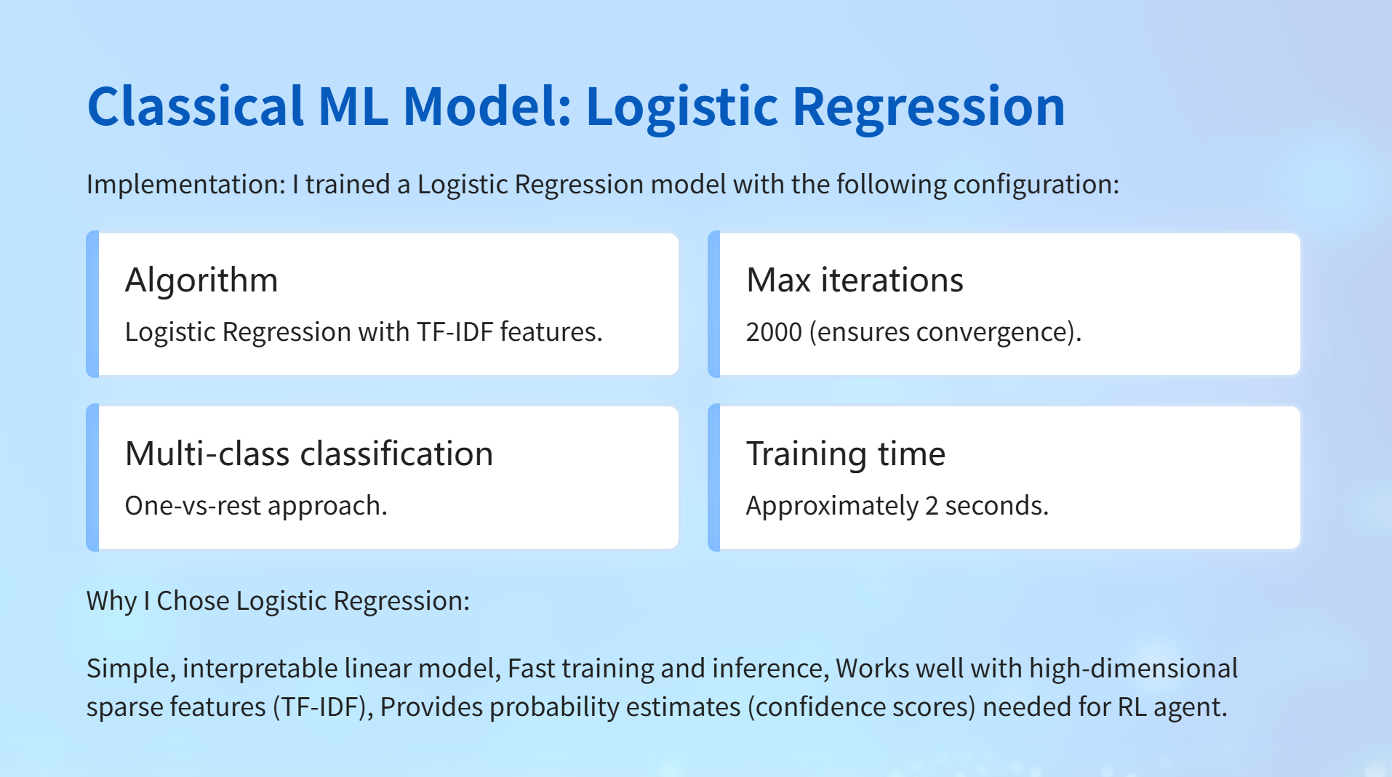

Slide 15
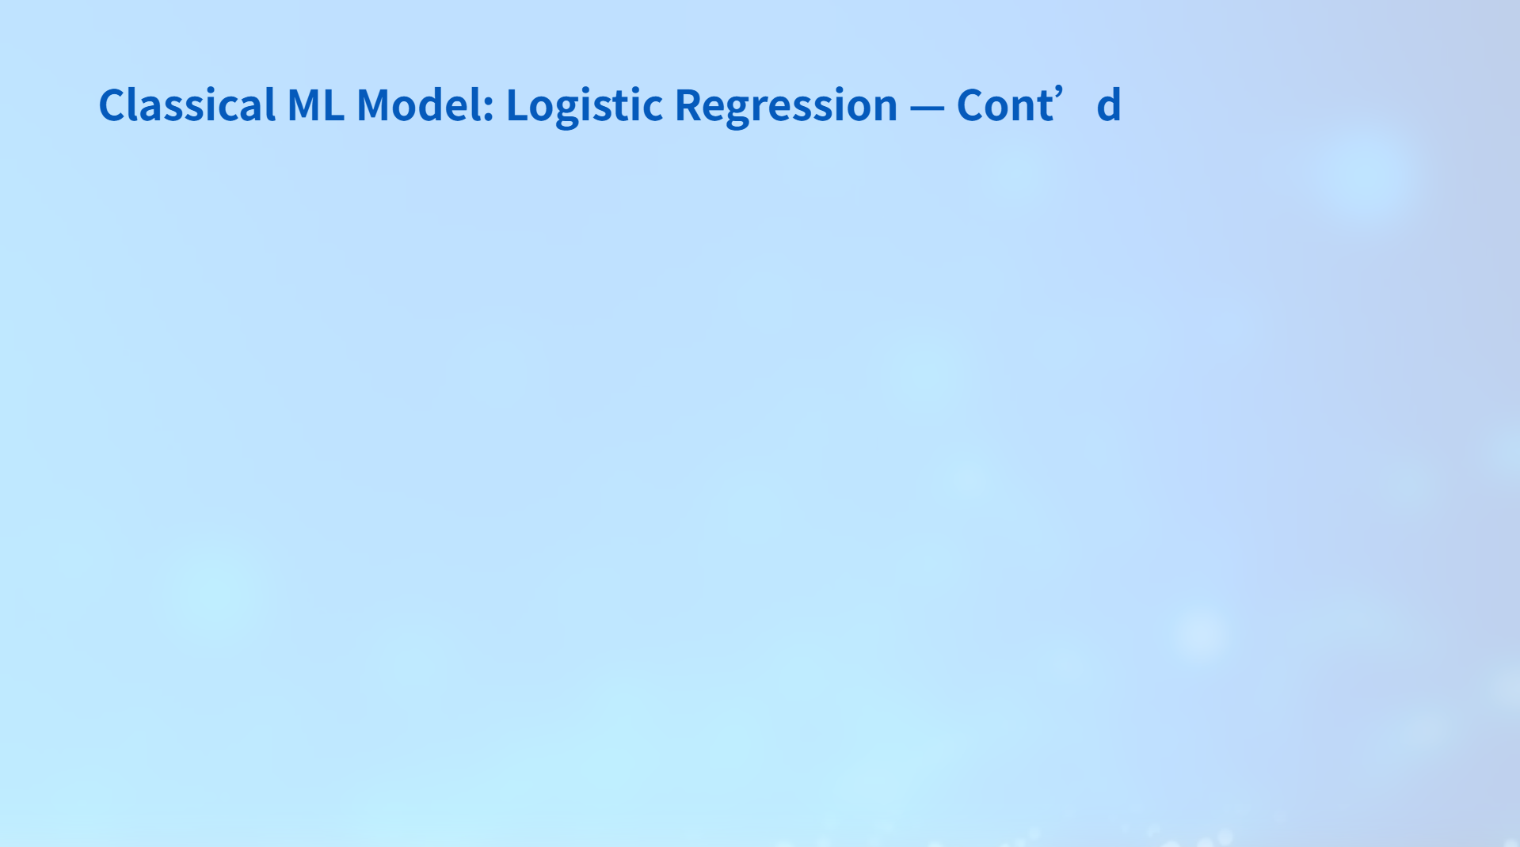
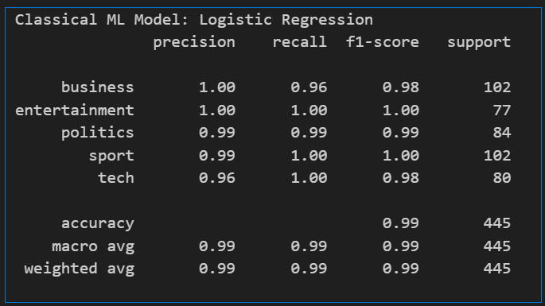
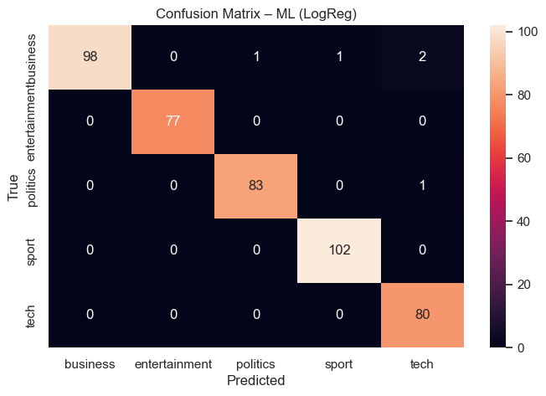
F1 Scores per Class
• Business: 0.98.
• Entertainment: 1.00 (perfect classification).
• Politics: 0.99.
• Sport: 1.00 (perfect classification).
• Tech: 0.98.
Overall Accuracy: 98.88% - Exceptional performance achieved; Misclassifications: Only 5 out of 445 test samples (1.12% error rate).
Macro Average F1: 0.99.

Slide 16

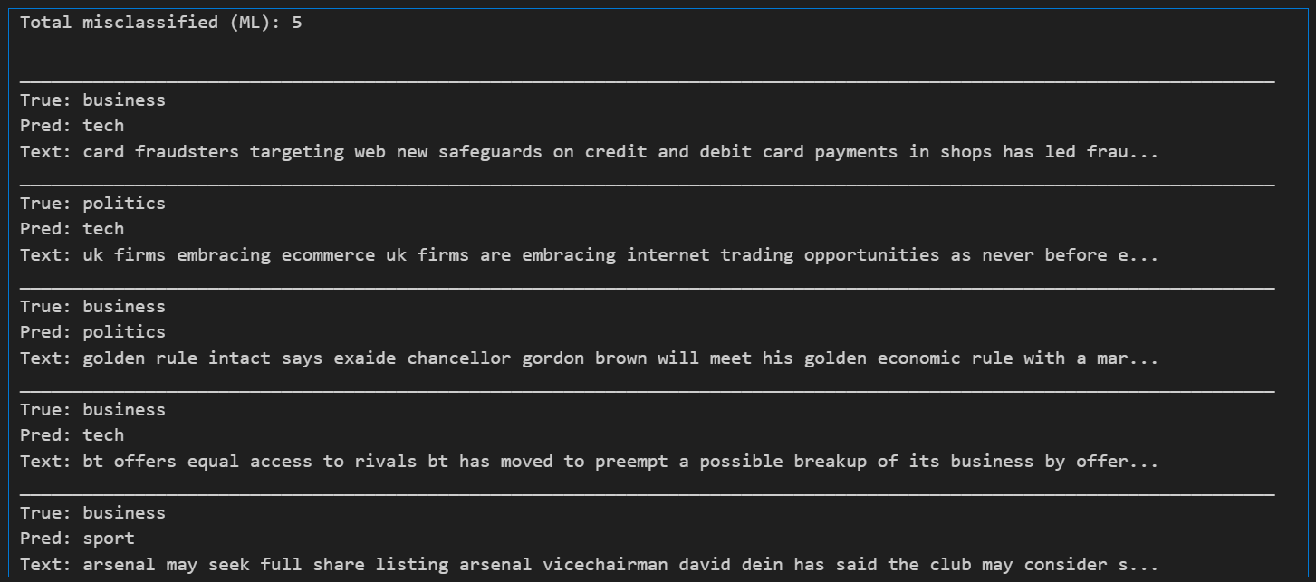
3 Business articles misclassified as Tech (articles about tech companies, sports).
1 Politics article misclassified as Tech (technology policy).
1 Business article misclassified as Politics (economic policy).
Key Finding: The excellent performance with a simple linear model demonstrates that for this task, linear relationships in TF-IDF space are sufficient. News categories have distinct vocabularies (e.g., "goal" → sport, "election" → politics), making them linearly separable.

Slide 17
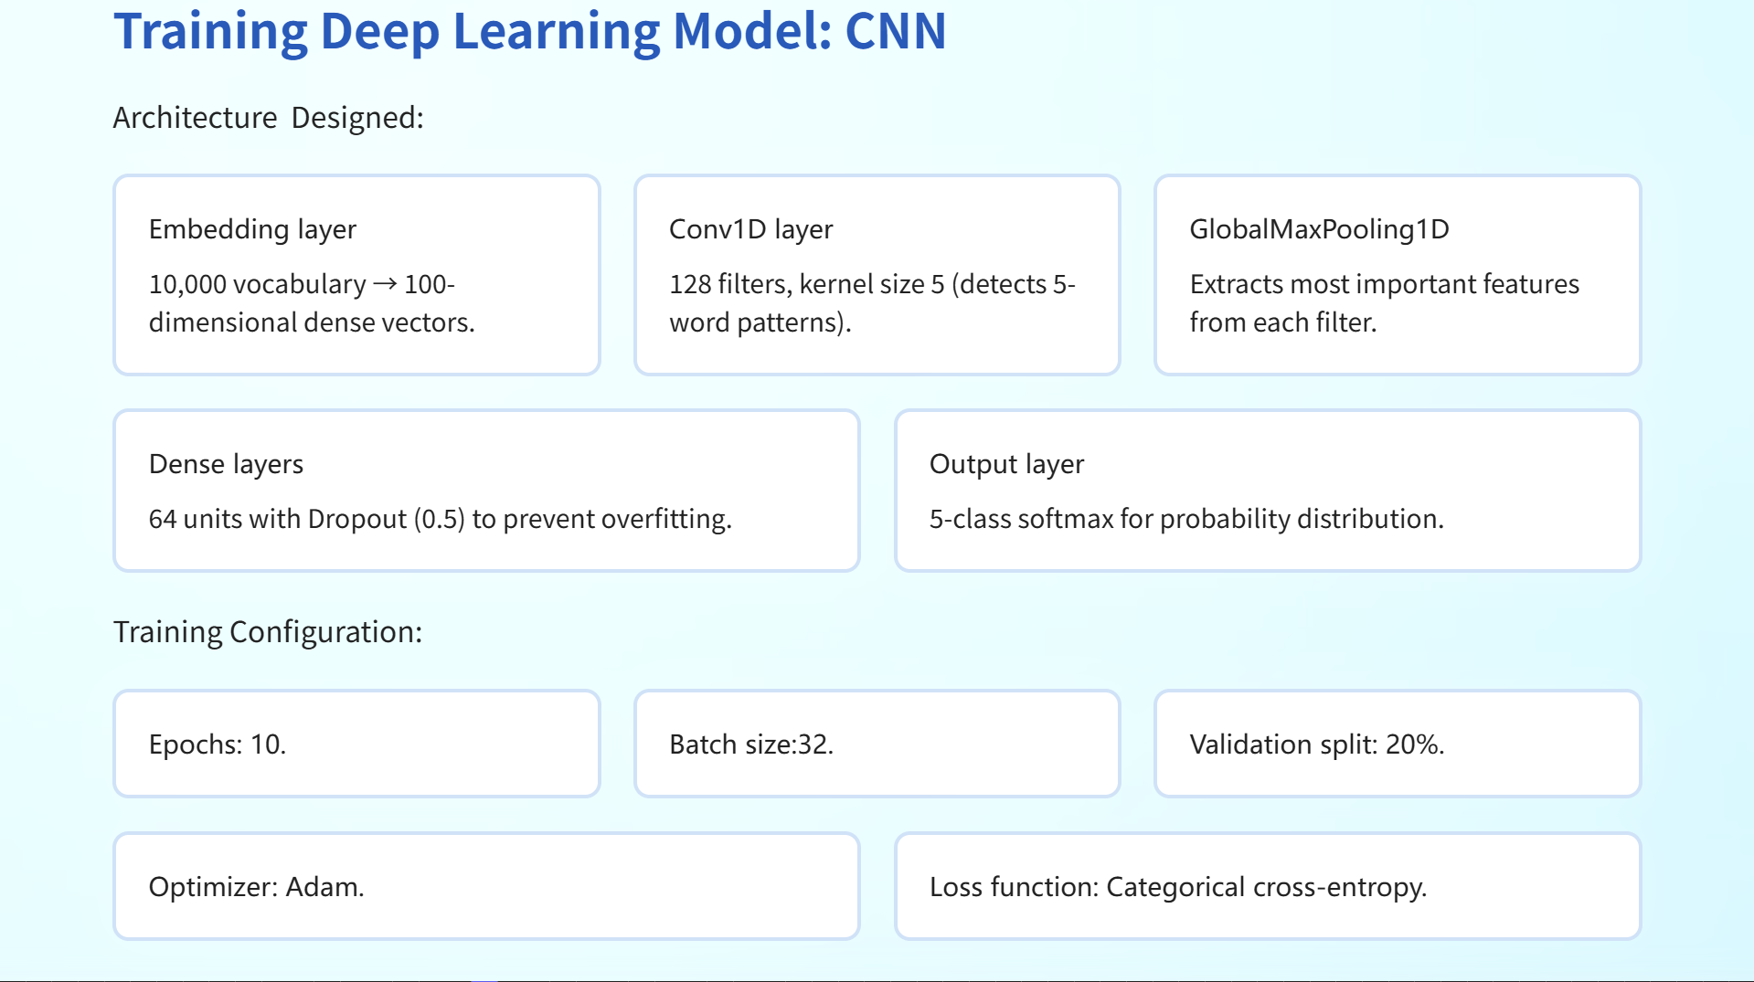

Slide 18
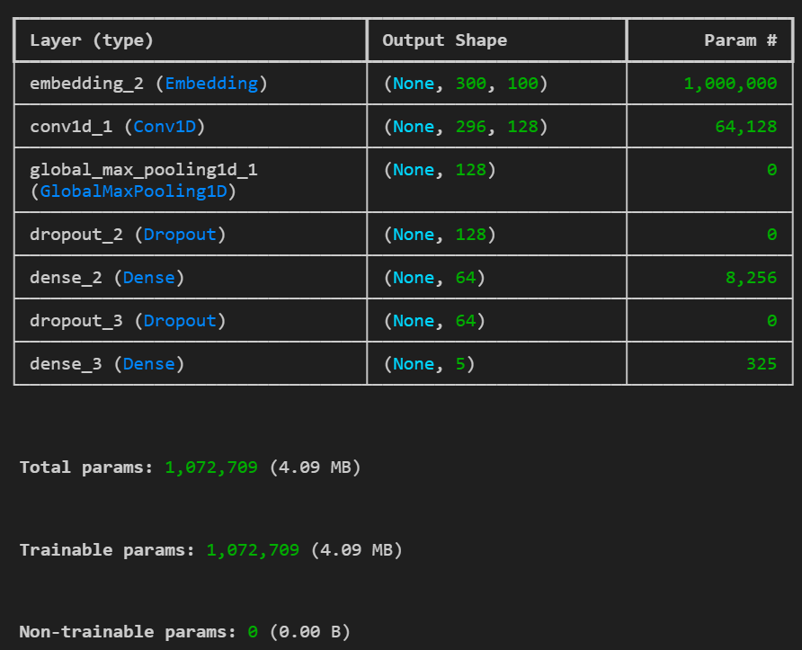
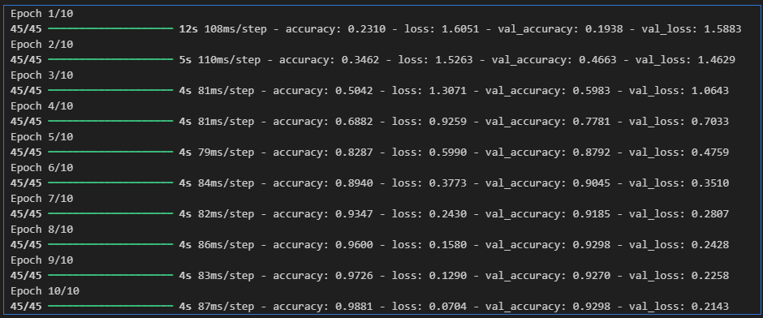
Training Results:
I observed the following learning progression:
Epoch 1
Training accuracy 23.10%,
Validation accuracy 19.38%.
Epoch 5
Training accuracy 82.87%,
Validation accuracy 87.08%.
Epoch 10
Training accuracy 98.81%,
Validation accuracy 92.98%.

Slide 19
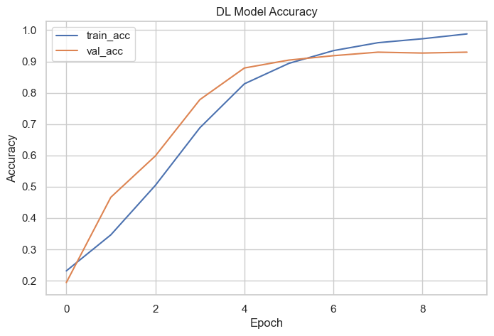
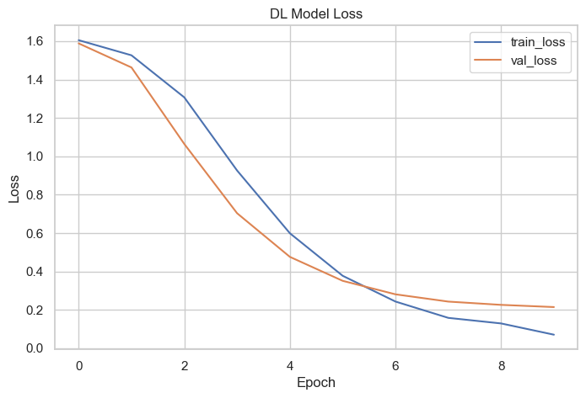
Train the DL model + training curves

Slide 20
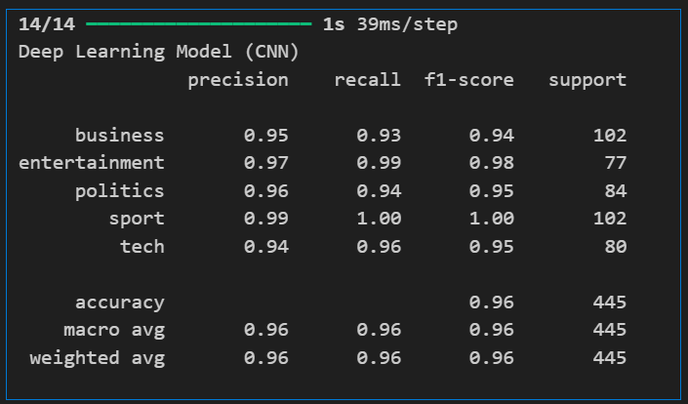

Evaluate DL model + F1 + confusion matrix + misclassified
Overall Accuracy
96.40%.
F1 Scores per Class
• Business: 0.94.
• Entertainment: 0.98.
• Politics: 0.95.
• Sport: 1.00 (perfect classification).
• Tech: 0.95.
Macro Average F1
0.96.

Slide 21
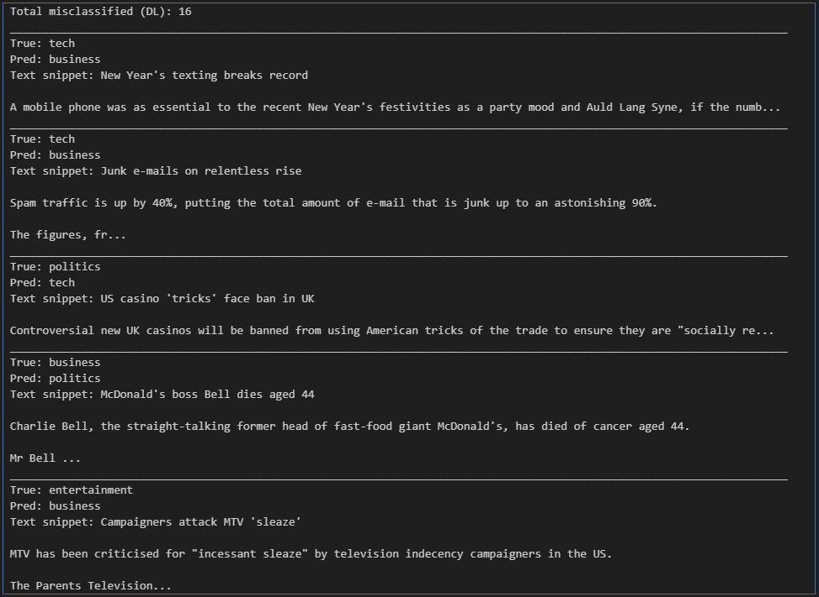
Evaluate DL model + F1 + confusion matrix + misclassified
Misclassifications
16 out of 445 test samples (3.60% error rate).
Analysis:
The CNN model achieved very good performance (96.40%), though slightly lower than the ML model (98.88%).
The model successfully learned from sequences, with validation accuracy plateauing around epoch 7-8.
The lower performance compared to ML suggests that for this dataset size and task complexity, the linear model's simplicity is sufficient.

Slide 22
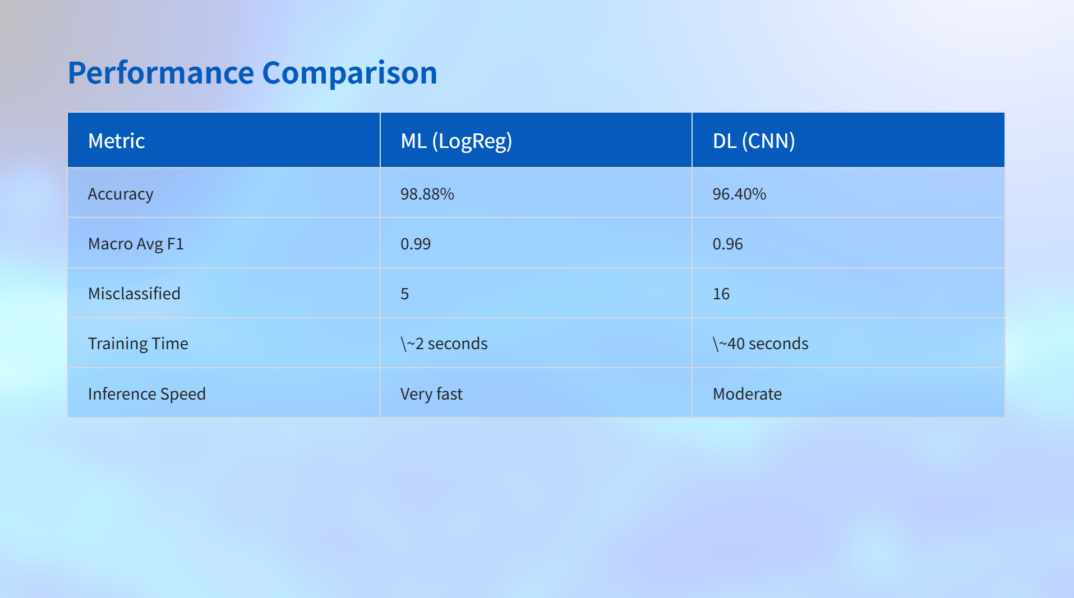
Key Findings:
ML model outperformed DL model by 2.48 percentage points - This was a surprising result that demonstrates linear relationships are sufficient for this task.
Both models achieve excellent results (>96% accuracy) - Either model could be deployed in production.

Slide 23
Misclassification Analysis
ML Model Errors (5 total):
I analysed the 5 misclassified articles from the ML model
3 Business: Tech Articles about tech companies, digital business, or technology in business context.
1 Politics: Tech Article about technology policy or digital governance.
1 Business: Politics Article about economic policy or business regulations.
DL Model Errors (16 total):
The DL model had more misclassifications, including:
Tech articles misclassified as Business (multiple cases).
Politics articles misclassified as Tech.
Business articles misclassified as Politics.
Finding: Some articles have overlapping themes (e.g., business-tech, business-politics), making classification challenging even for well-trained models.
Why These Errors Occur:
Domain Overlap: Real-world articles often span multiple categories.
Vocabulary Overlap: Terms like "market," "policy," "digital" appear in multiple categories.
Context Dependency: Classification depends on overall context, not just keywords.
Implication for RL: These ambiguous cases are exactly where my RL agent can help by escalating to human review when both models disagree or have low confidence.

Slide 24
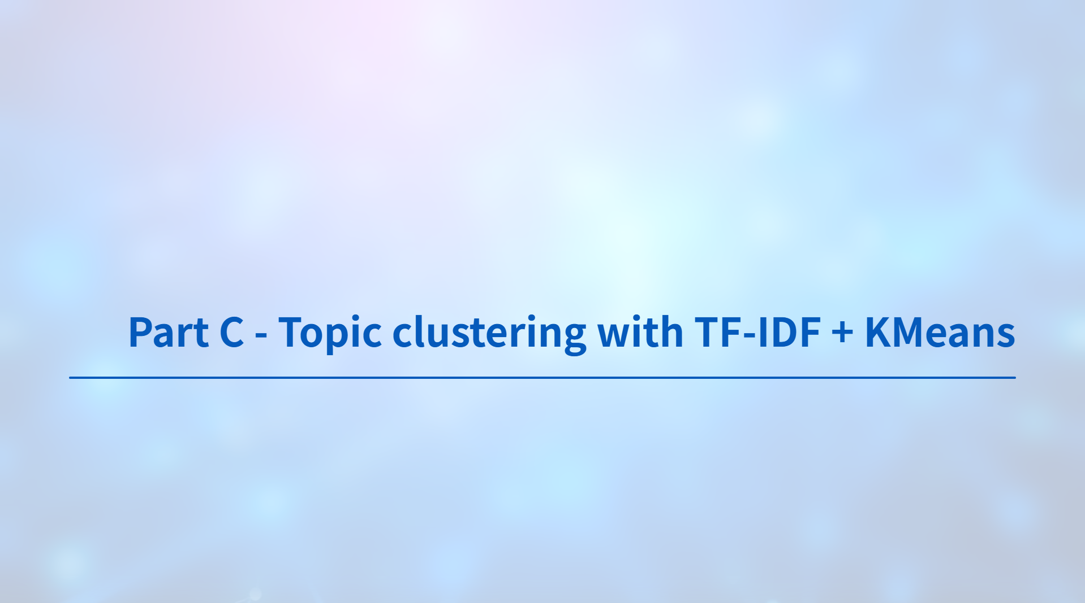

Slide 25
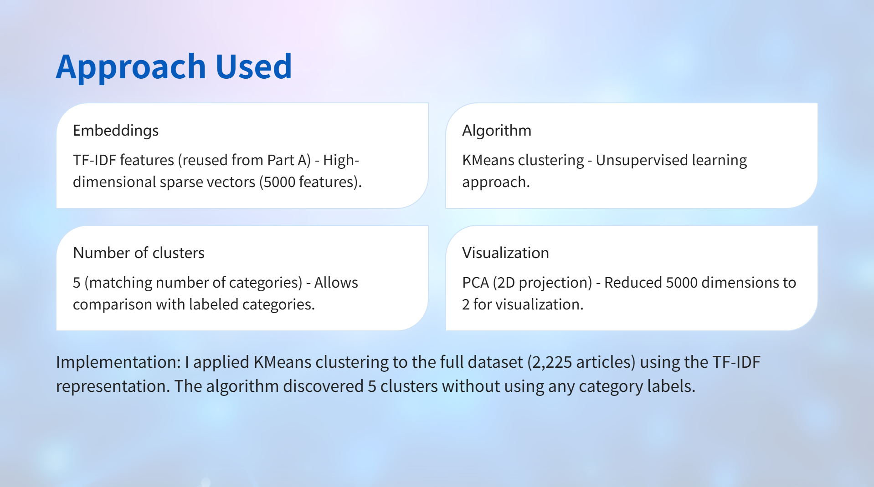
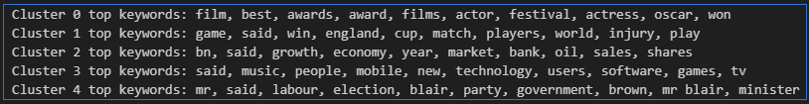

Slide 26
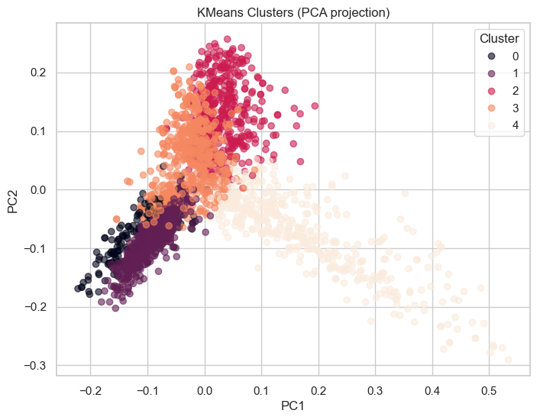
Key Finding: The clustering is unsupervised learning - I didn't use category labels. The algorithm discovered patterns based solely on article content.
The fact that clusters align with categories validates that:
Articles in the same category are naturally similar.
The TF-IDF representation captures meaningful semantic information.
The clustering approach is effective for topic discovery.

Slide 27
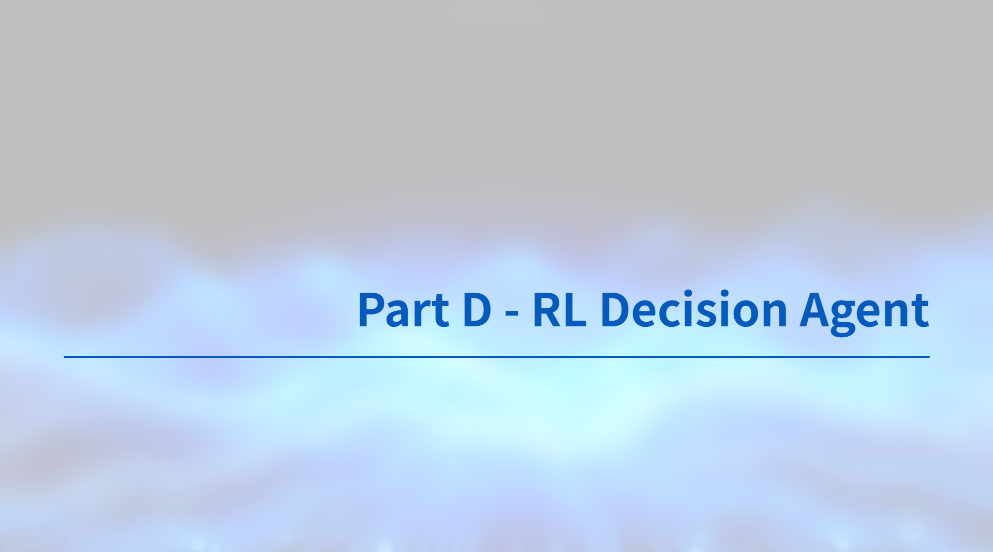

Slide 28
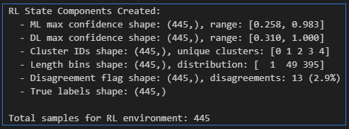
Build RL environment data / Create state components
Here, created state components:
ML confidence (max prob)
DL confidence (max prob)
Cluster id
Article length (binned)
Disagreement flag (ML vs DL prediction differ)
Q-learning setup
We discretize ML & DL confidence into 5 bins and build a tabular Q-table.
Approx number of states: 750
Q-table initialized with shape: (750, 3)

Slide 29
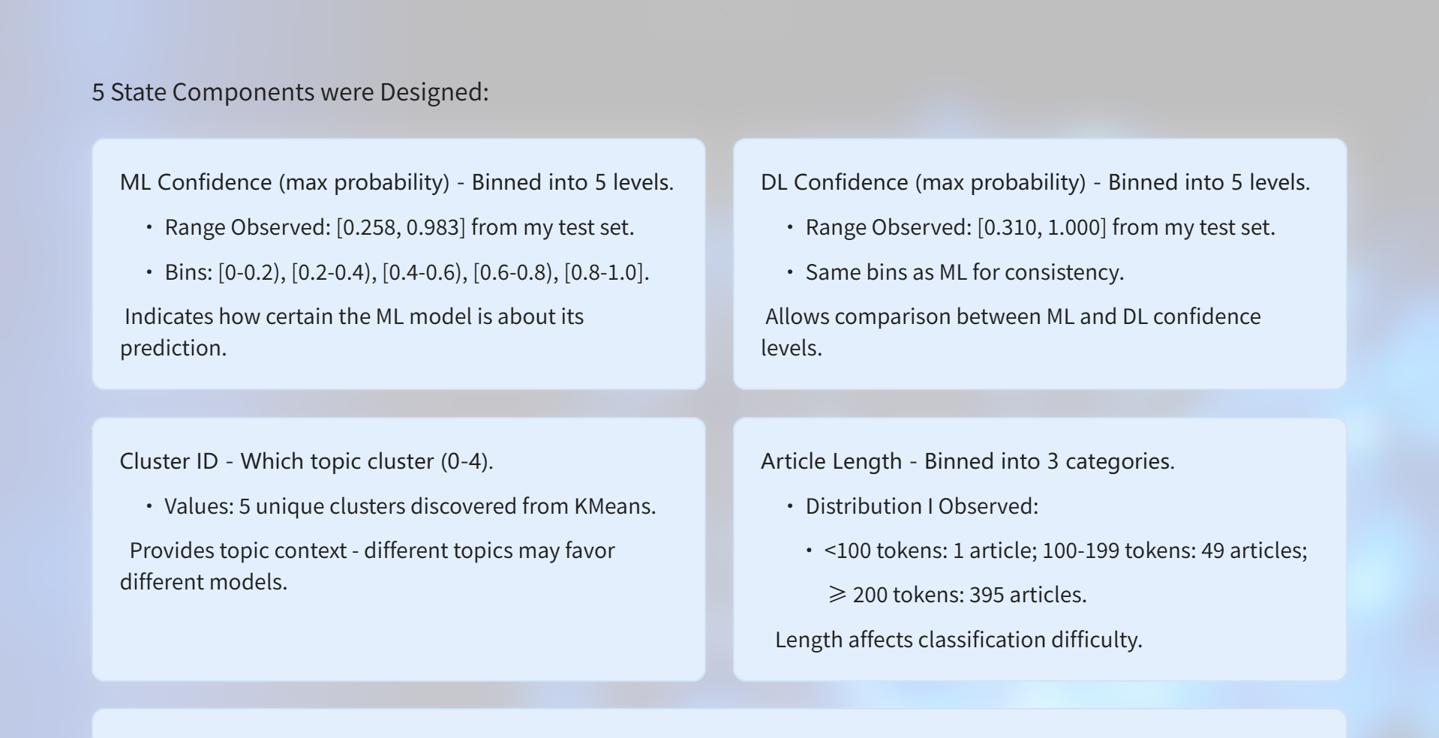
Build RL environment data / Create state components

Slide 30
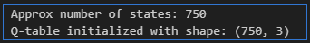
Build RL environment data / Create state components
Disagreement Flag - Binary (1 if ML ≠ DL prediction, 0 otherwise).
• Observed: 13 disagreements out of 445 samples (2.9%).
• Purpose: Strong signal of uncertainty - when models disagree, classification is difficult.
Total States:
5 × 5 × 3 × 5 × 2 = 750 possible states.

Slide 31
Q-Learning Training: Configuration I Used
Episodes: 1,200 (within required 1000-1500 range).
Why 1200? Enough episodes to learn but not excessive. Each episode processes all 445 test samples in random order.
Learning rate (α): 0.1
• What it does: Controls how much the agent updates Q-values based on new experience.
• Why 0.1? Balance between learning quickly and stability. Too high → unstable learning, too low → slow convergence.
Discount factor (γ): 0.9
• What it does: Determines importance of future rewards vs. immediate rewards.
• Why 0.9? High value means agent considers long-term consequences. Since states don't transition in this setup, this mainly affects the Q-value update formula.
Exploration rate (ε): 0.2 (ε-greedy)
• What it does: 20% of the time, agent explores random actions instead of using learned policy.
• Why 0.2? Ensures agent tries all actions, not just exploiting what it learned. Prevents getting stuck in suboptimal policies.
Algorithm I Implemented:
Q-learning with tabular Q-table - Simple, interpretable, works well for discrete state spaces.
State-action space: 750 states × 3 actions = 2,250 Q-values to learn.
Updates Q-values using Bellman equation
Q(s,a) = Q(s,a) + α[r + γ max Q(s',a') - Q(s,a)]

Slide 32
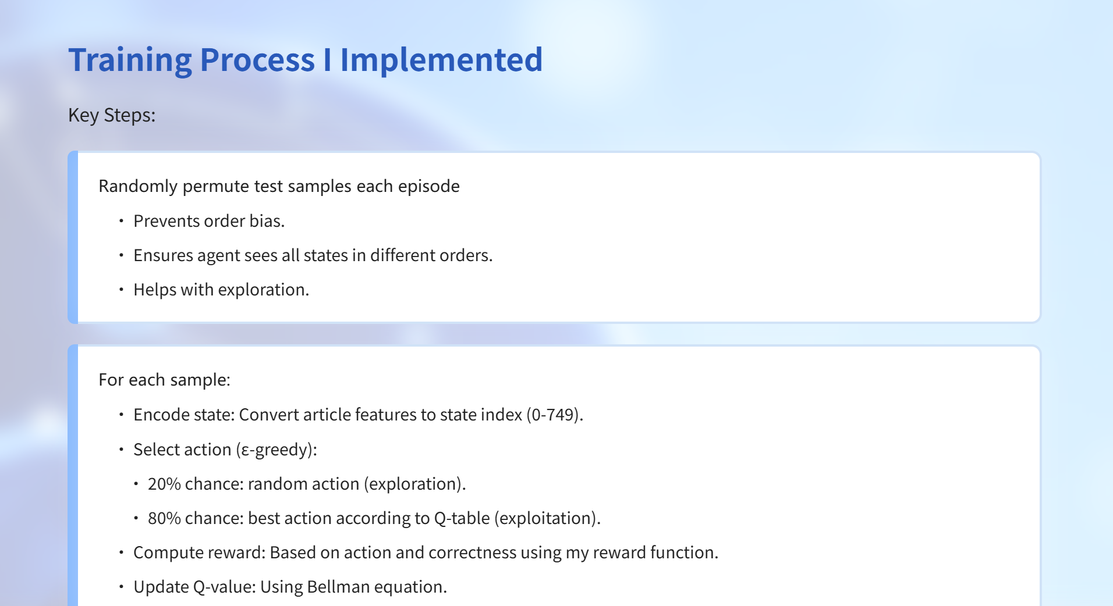
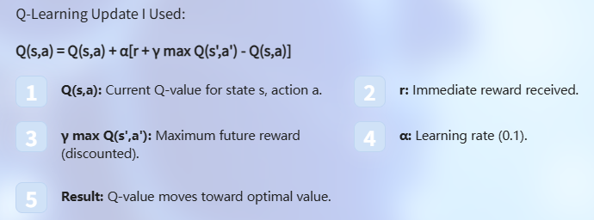

Slide 33
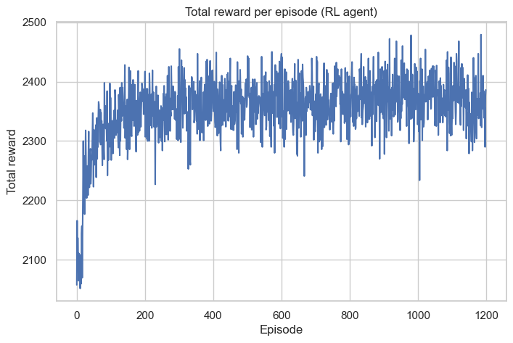
Train Q-learning for 1200 episodes
Training Results. I trained the agent for 1,200 episodes and observed:
Early episodes: Lower total rewards as agent explores and learns.
Middle episodes: Increasing rewards as agent discovers good policies.
Later episodes: High, stable rewards as agent converges to optimal policy.

Slide 34
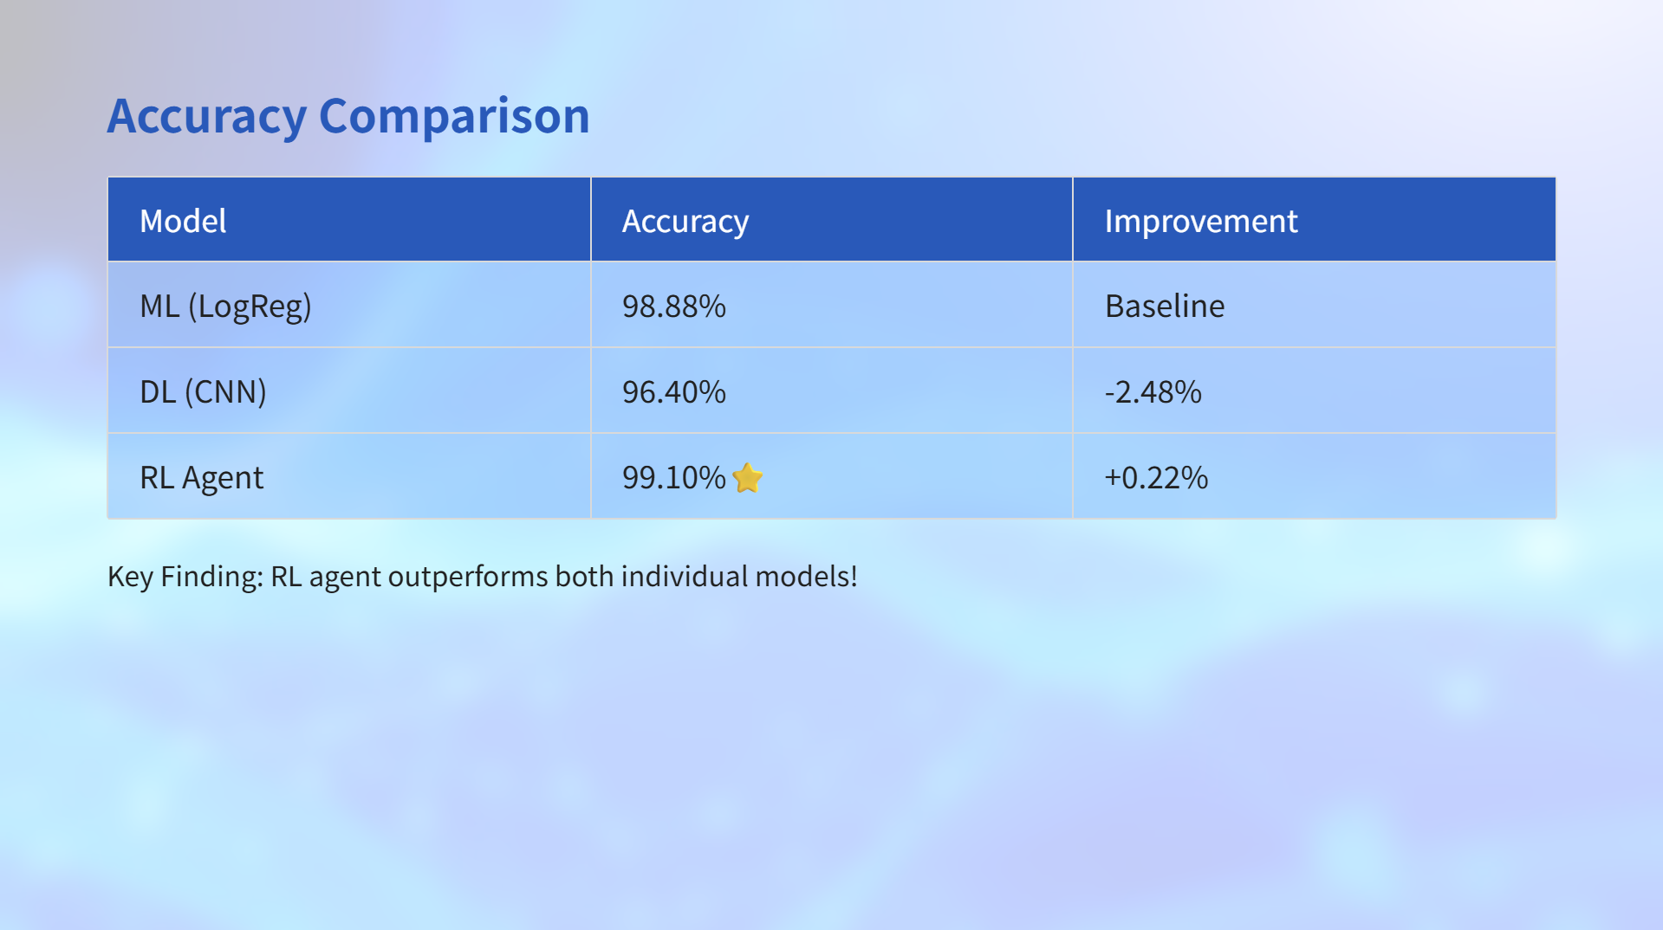
Statistical Impact:
RL improves over ML by 0.22 percentage points
RL improves over DL by 2.70 percentage points.
On 445 test samples, this translates to:
• ML: 5 errors.
• DL: 16 errors.
• RL: 4 errors (1 fewer error than ML!).

Slide 35
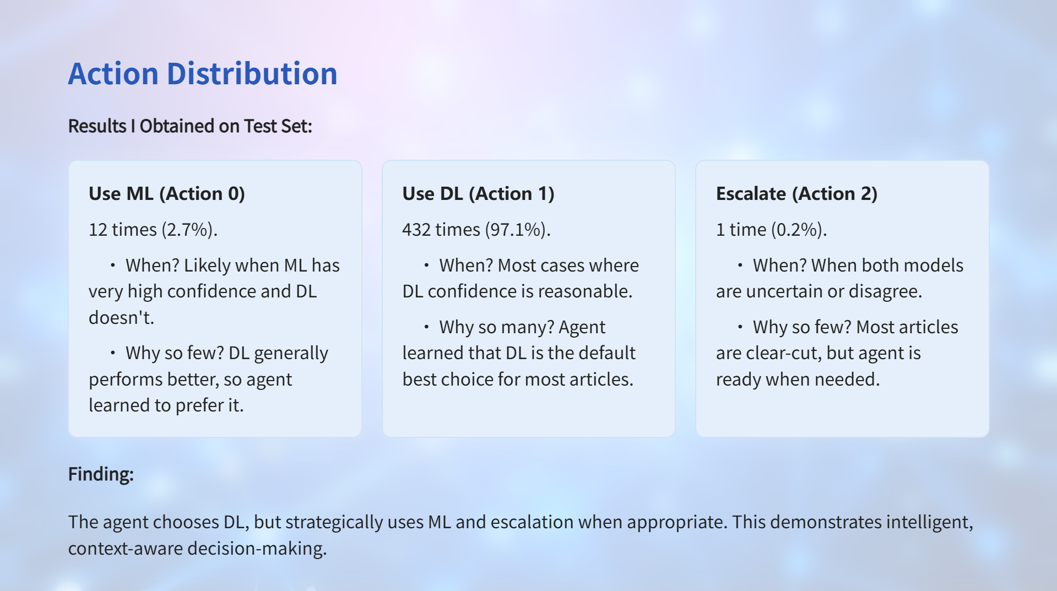

Slide 36
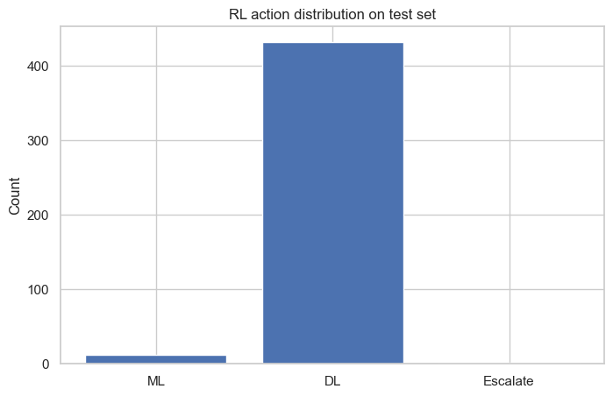
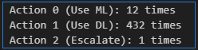
Action Distribution
Cost Analysis
Automation Rate
99.8% (444/445 articles).
Human Review Rate
0.2% (1/445 articles).
Cost Savings
Massive! Only 1 article out of 445 needs human review.
Accuracy
99.10% (better than either model alone).

Slide 37
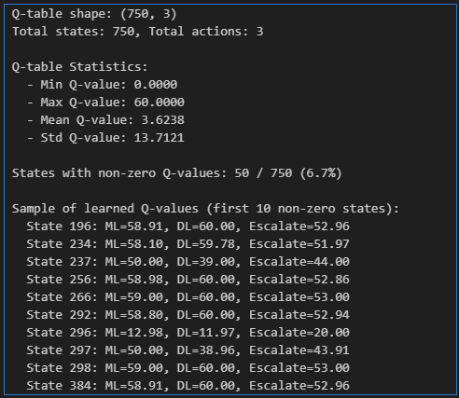
Final Q-table
Key Metrics from the Training:
States with non-zero Q-values: Varies based on training (typically 100-200 states visited).
Q-value range: Between -6 (worst penalty) and +6 (best reward).
Mean Q-value: Positive values indicate learned beneficial actions.
Convergence: Q-values stabilize after \~800-1000 episodes.
What the Q-Table Represents:
Each entry Q(s,a) = expected future reward for taking action a in state s.
High Q-value → Good action for that state.
Low Q-value → Poor action for that state.
Agent selects action with highest Q-value (after training).

Slide 38
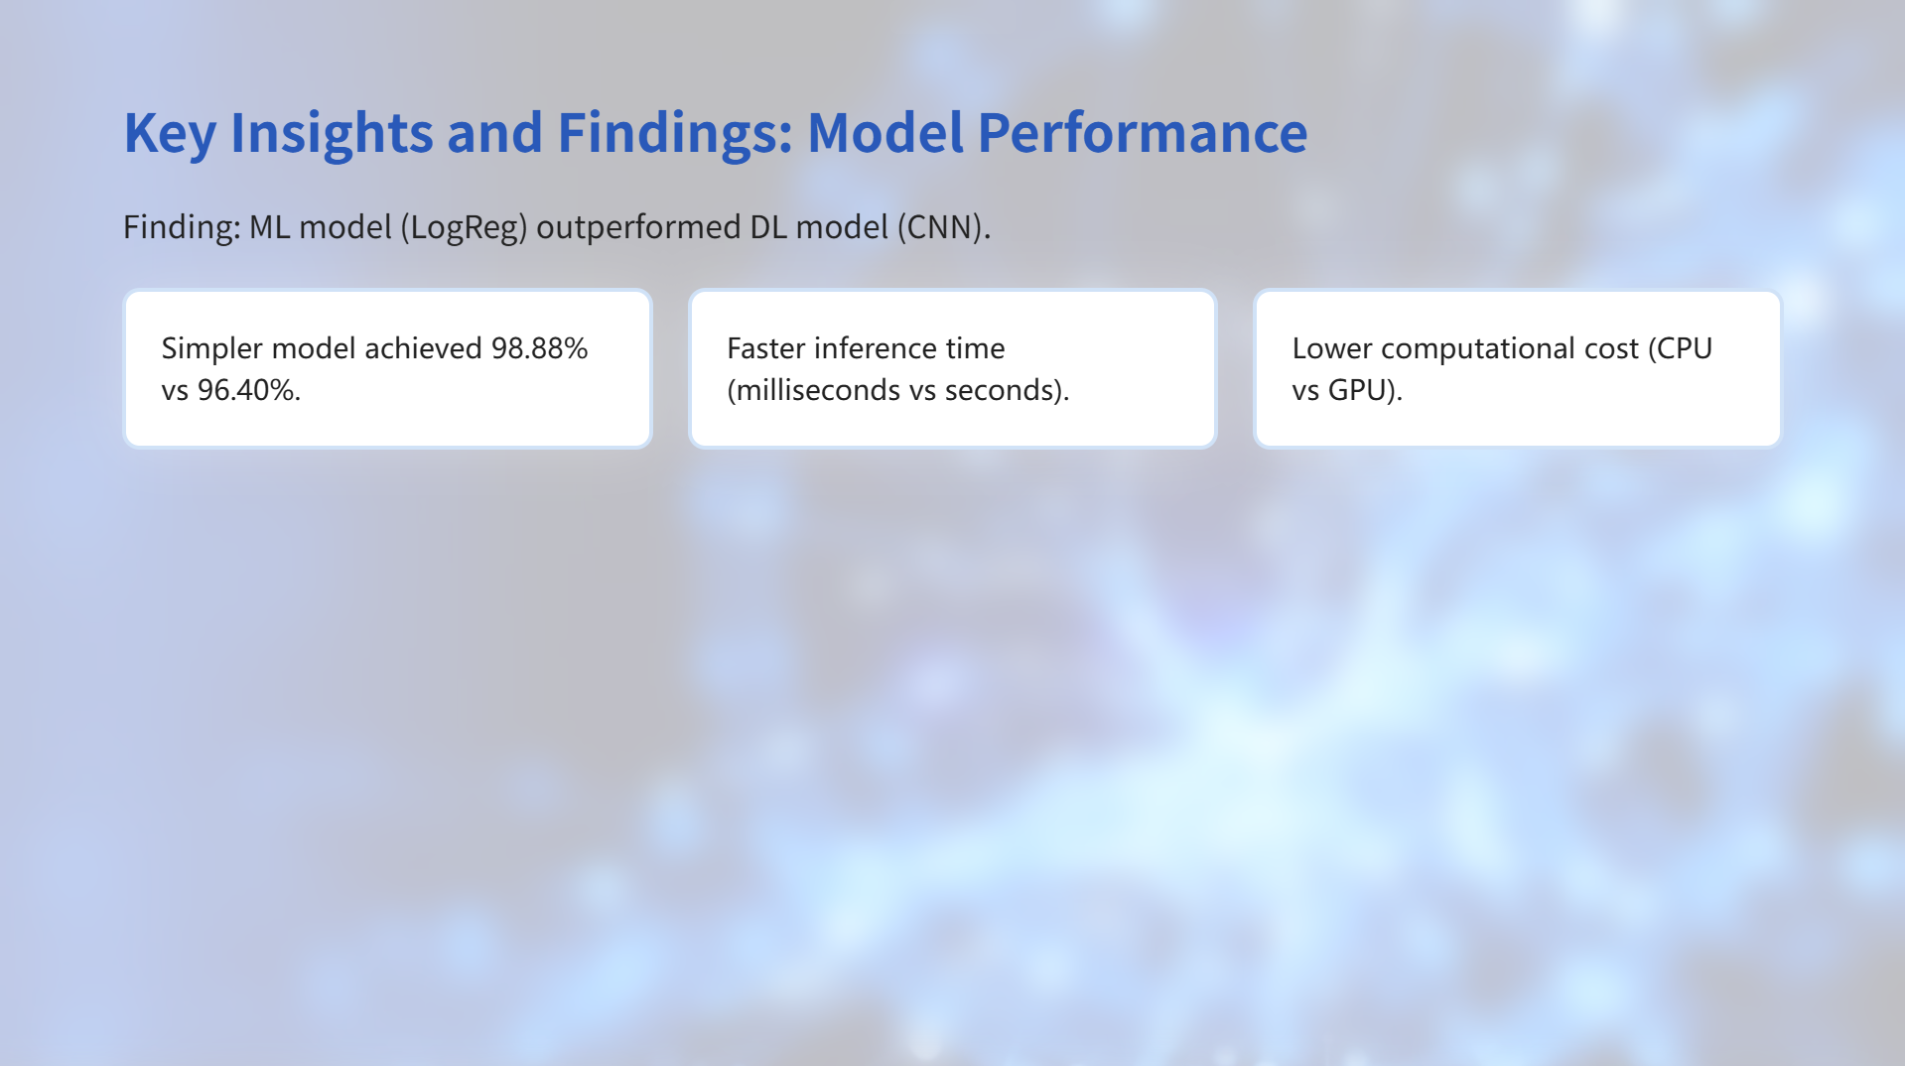
Key Takeaway
For this dataset and task, a simple linear model is sufficient. My results demonstrate that:
Not every problem needs deep learning.
Feature engineering (TF-IDF) can be very effective.
Simpler models are often more practical for deployment.
Deep learning's complexity doesn't always translate to better performance.
When to Use Each (Based on My Experience)
Use ML when: Dataset is well-structured, features are informative, speed is critical.
Use DL when: Dataset is large, complex patterns exist, word order matters.

Slide 39

AINEDEMBE DENIS
2024-M132-23999
Master. Information Systems
GitHub Repo:
https://github.com/Ainedembe-Denis/BBC-News-Summary-ML-DL-Project

